Slide 1

Customer Video 1

Slide 2

Farmers Hub App
Presented By Team 1:
Vikramjeet Singh
Jaideep Singh
Dexter Eromosele
Samuel Orekoya
Joseph Ajeigbe
Muhammed Abou-Hantash

Slide 3
Introduction To The App
Welcome to Farmers Hub App, where agricultural trade meets innovation. Our platform serves as a pivotal link between farmers and consumers, enabling farmers to effortlessly sell their produce and machinery directly to customers or other farmers.
By cutting out middlemen and their associated commissions, Farmers Hub ensures that farmers earn fairer returns for their hard work.
Notes:
Here, Sam can quickly talk about the idea of the app stemming from his uncle’s story to kind of introduce the customer story for the audience.

Slide 4
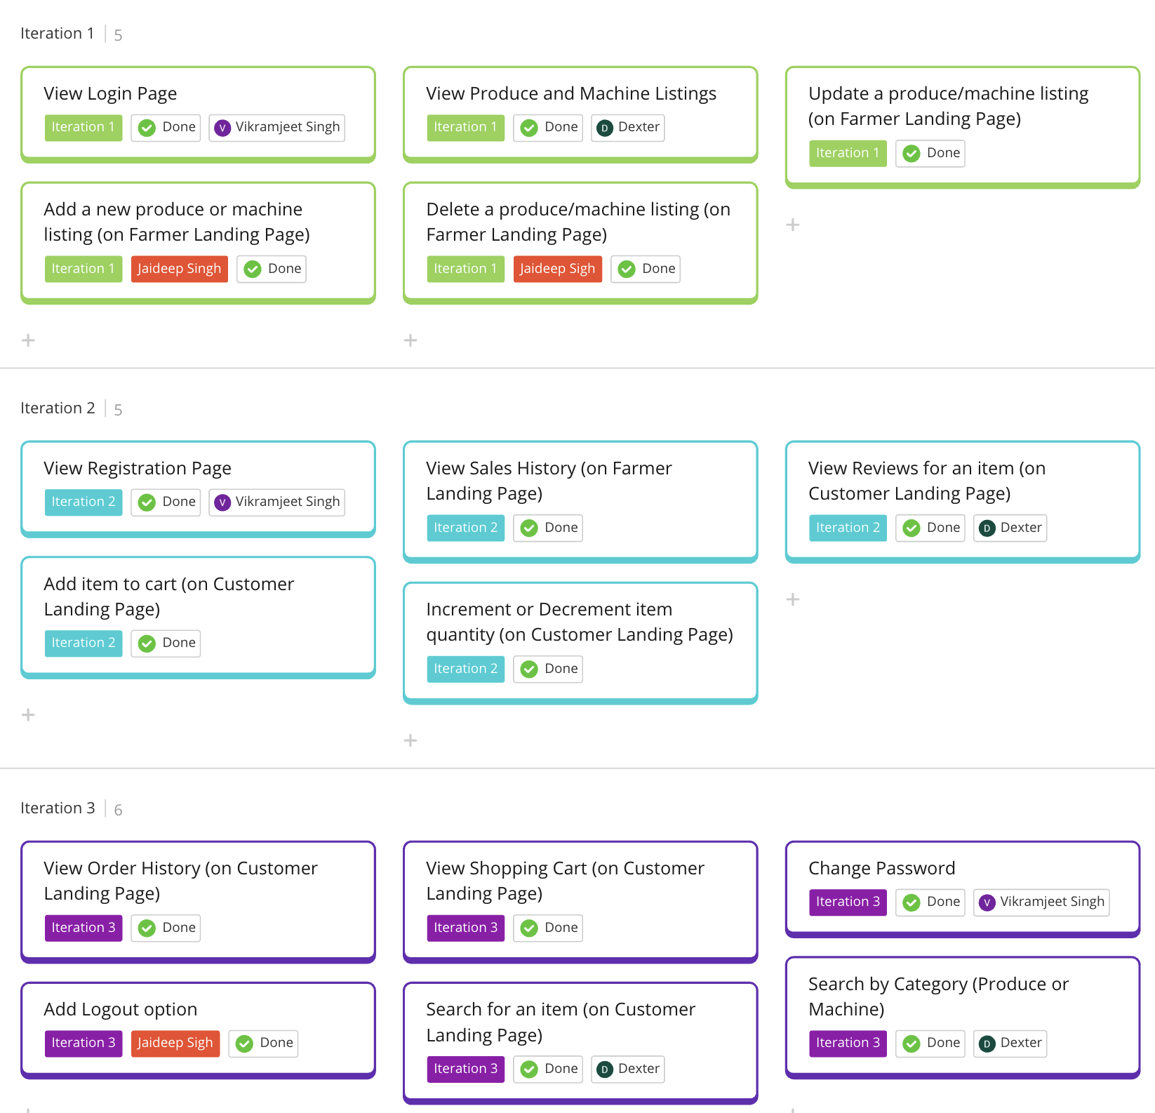
Features or
User Stories

Slide 5
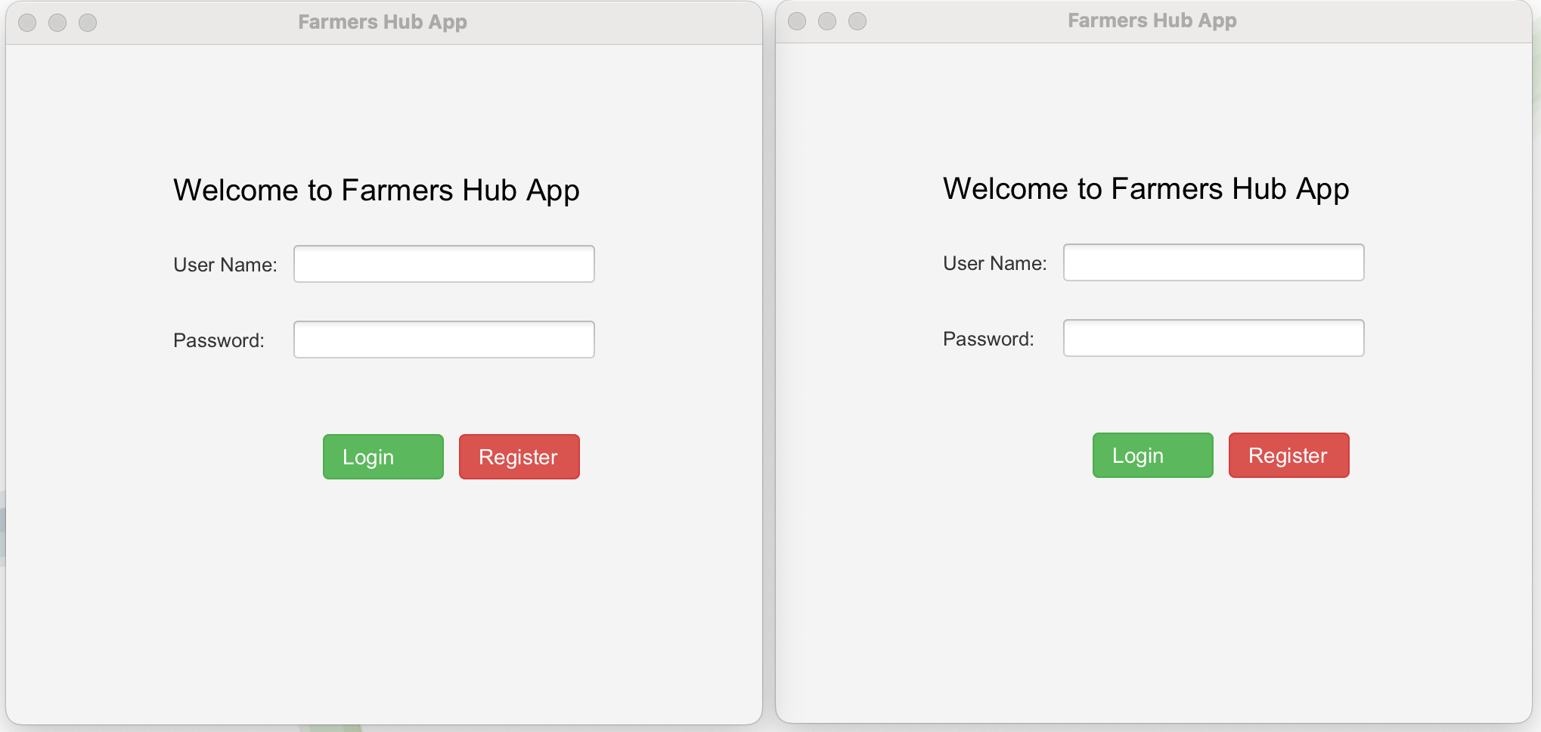
View Login Page
When the start button is pressed, two pages will display on the screen. New users have the option to register and create their login details. Upon entering their login credentials, the app will direct them to the appropriate page, depending on whether they are a farmer or a customer.

Slide 6
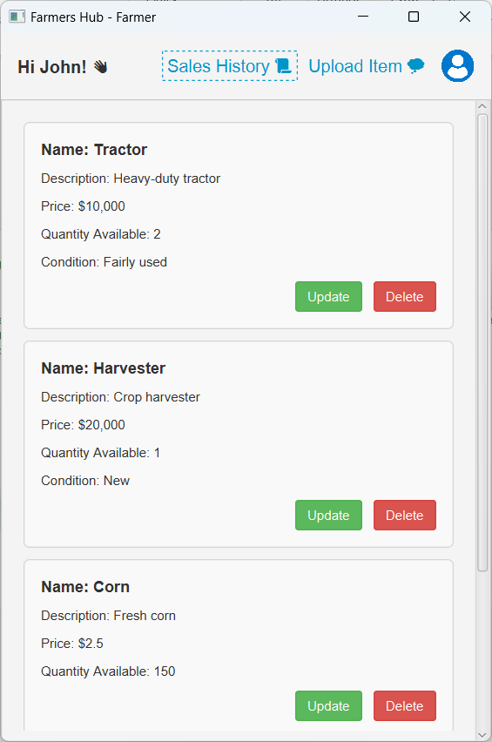
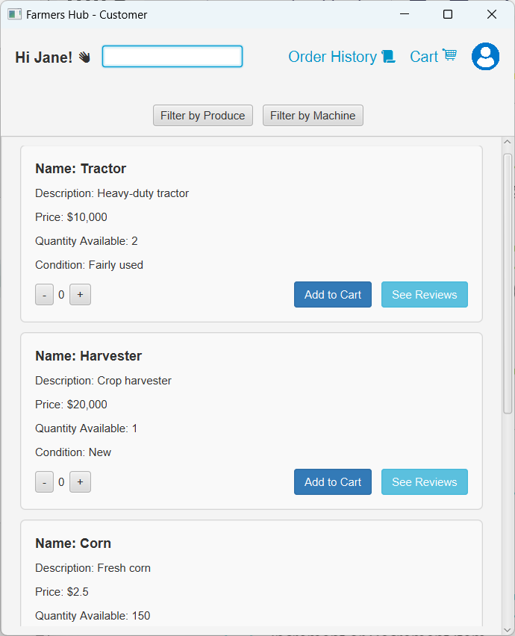
View Produce and Machine Listings
After Logging in, farmers will be able to view what they have posted for sale, while customers will be able to view what is available to buy.

Slide 7

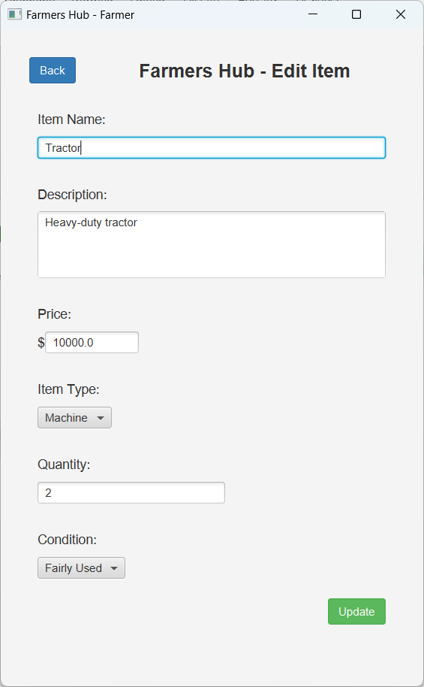
Update a Produce/Machine Listing
When farmers click the green "Update" button on the farmers landing page, they are directed to a new page where they are given the option of editing every component of their pre-existing listing.

Slide 8
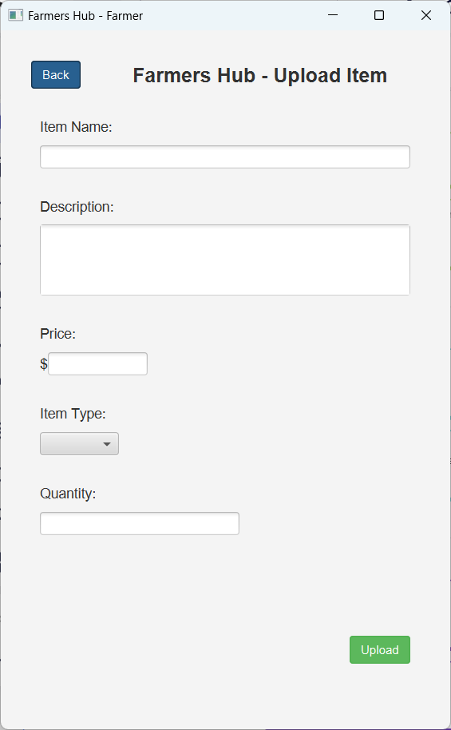
Add a New Produce or Machine Listing
When the farmer clicks the blue lettered "Upload Item" button on the farmers landing page, they are brought to a new page where they are given the option to add a new item and asked to fill out the item's name, description, price, type, and quantity.

Slide 9
Delete a Produce/Machine Listing
The farmers are also given the option of deleting any item they have added by simply Pressing the red “Delete” button

Slide 10
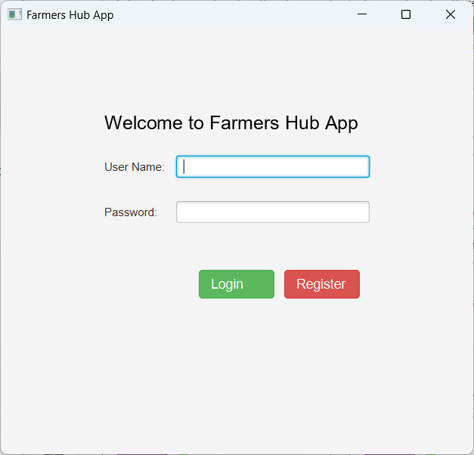
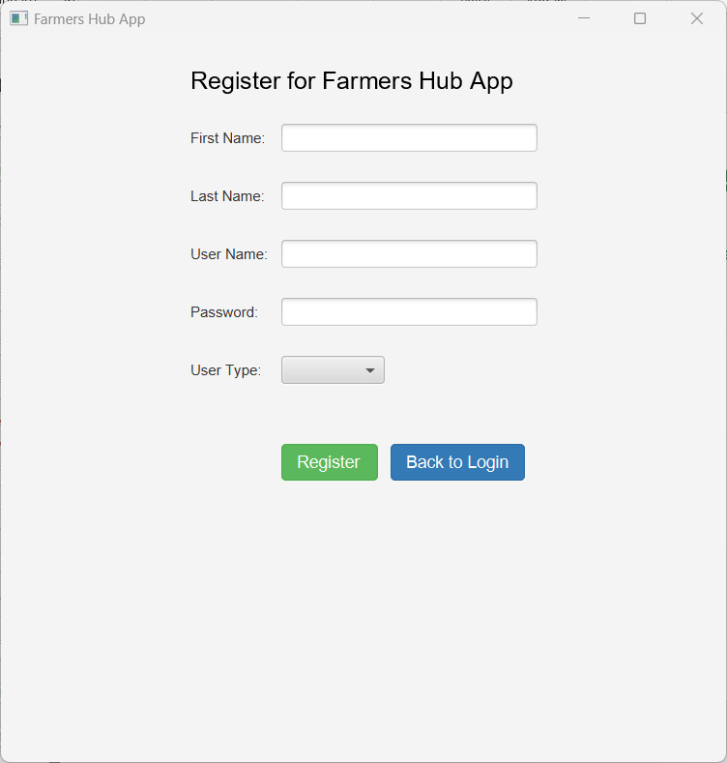
View Registration Page
Pressing the red "Register" button on the initial login page opens a new window in which you may enter your information and register as a farmer or a customer.

Slide 11
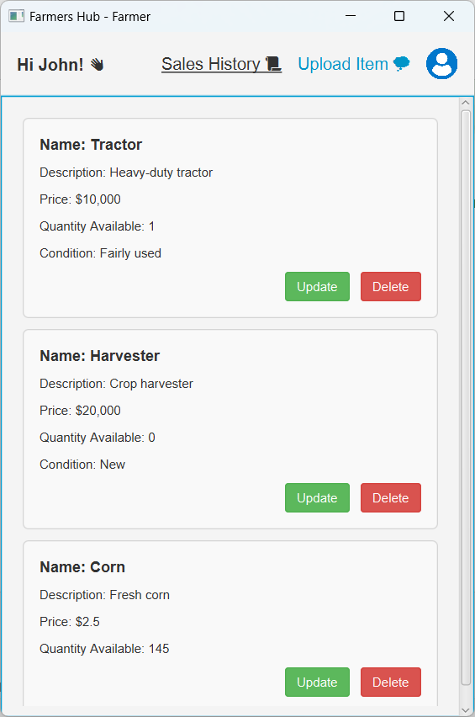
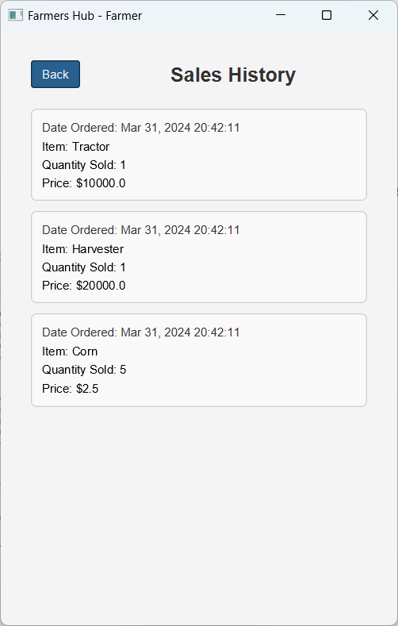
View Sales History
Pressing the "Sales History" button on the Farmers landing page sends you to another window that shows you all prior sales and offers you detailed information about the sale.

Slide 12
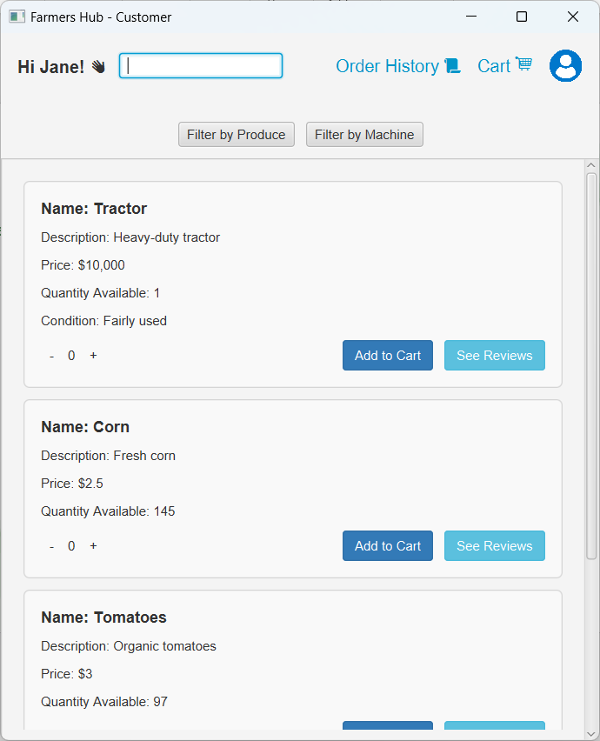
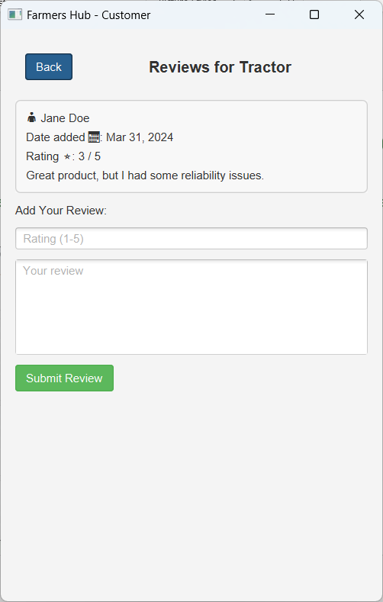
View Reviews for an Item
On the customer landing page, hitting the "See Reviews" button brings you to a new window where you can check past reviews and add your own new one.

Slide 13
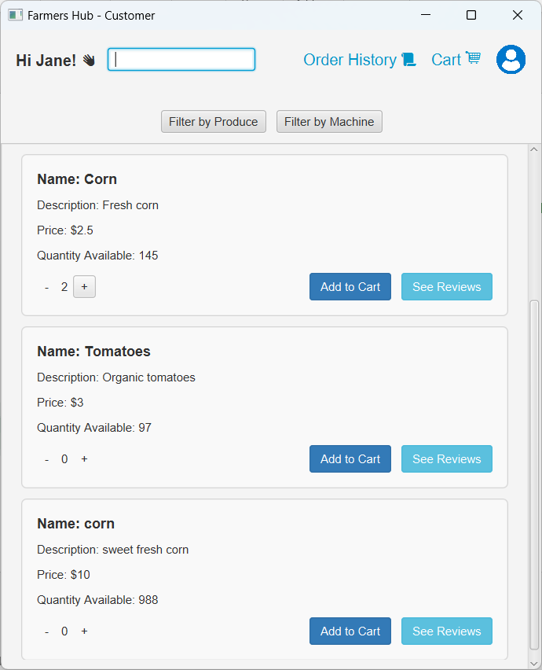
Add Item to Cart
On the Customer landing page you can add items to cart by pressing on the “Add to Cart” button

Slide 14
Increment or Decrement Item Quantity
Before adding to cart, you can increase and decrease the number of products you wish by hitting the "+" and "-" buttons, which are limited by the number of items available.

Slide 15
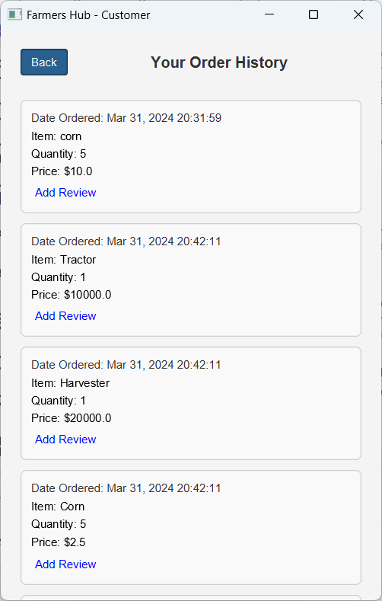
View Order History
On the customer's landing page, you can press on the "Order History" menu, which will take you to a new window where the customer can see their whole order history.

Slide 16
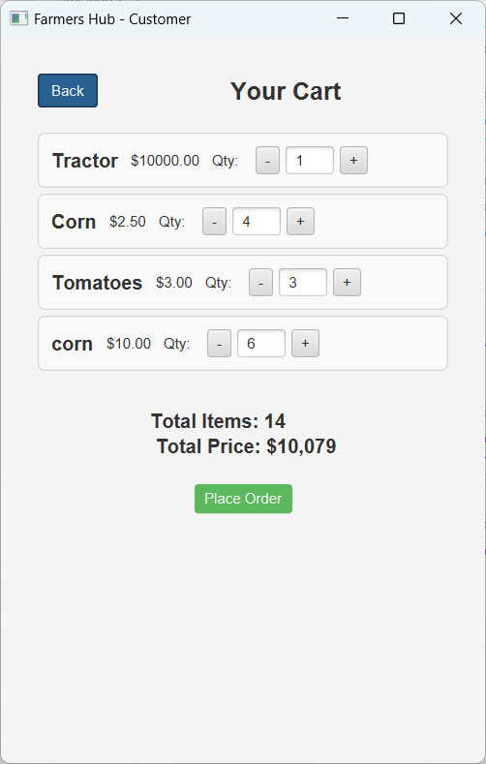
View Shopping Cart
On the customer landing page, selecting the "Cart" button leads you to a new window where it shows you every item you have picked to buy, as well as the total number of products, total price, and the option to place the order.

Slide 17
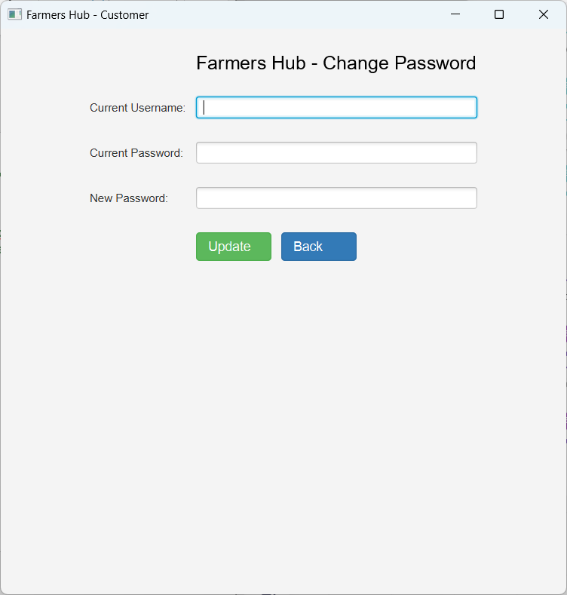
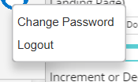
Change Password
The farmer or customer can change their password by pressing on the avatar icon in the upper right corner of the window and then selecting "change password" which will send them to a new window where they can change their password.

Slide 18
Logout option
The farmer or customer can log out by selecting "Logout" from the avatar symbol in the upper right corner of the window, which will log them out and return them to the login window.

Slide 19
Search for an Item
On the customer landing page, the customer can search for the item they're looking for by typing it into the search box at the top of the window.

Slide 20
Search by Category
On the customer's landing page, you have the option of filtering to only see Produce or Machine by hitting the respective buttons.

Slide 21

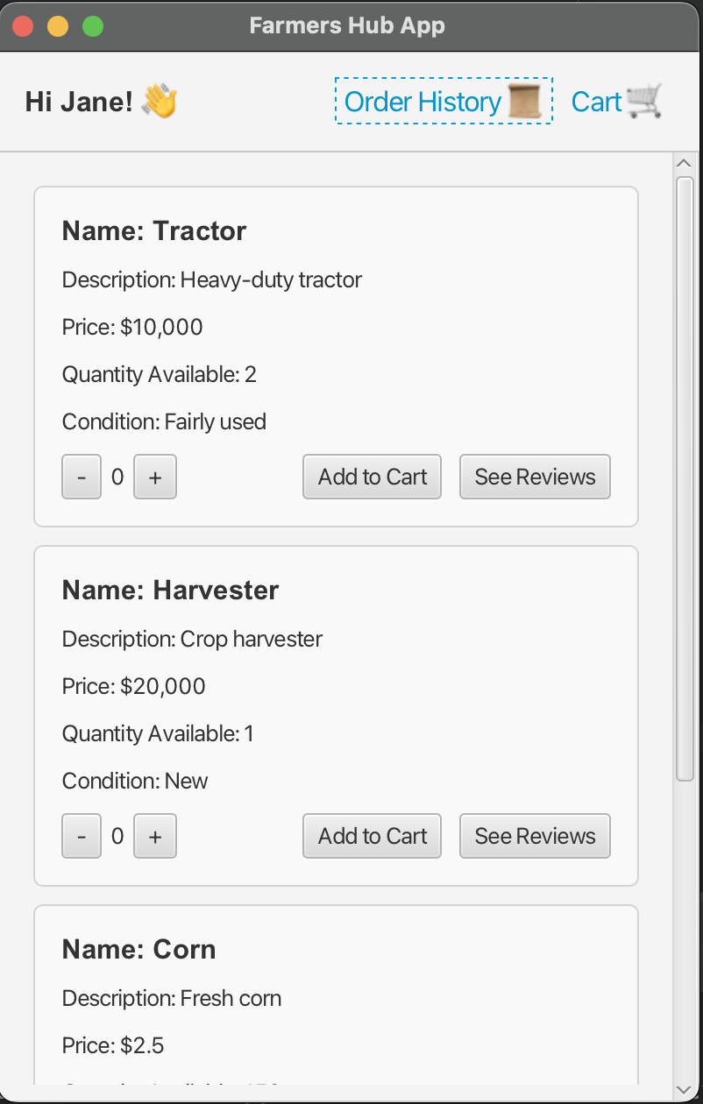
Post Mortem Analysis
How did the project change from your initial (iteration 0) vision or stories, or did it work out as predicted?
Notes:
The minor changes from what we first envisioned mostly originated from our customer and the professor. Their feedbacks and responses allows us to further elevate our application from as originally predicted. The idea to implement a search and sort function really helps to elevated the application’s efficiency while as well making it user friendly. All in all, it worked out as predicted if not better.

Slide 22

Post Mortem Analysis
Did any features work better than expected?
Notes:
Yes, the search and sort feature. We thought initially that it’ll search strictly the exact words but not expected it to filter “produce and machinery” items when they’re somehow typed/spelt wrong. This is really THE one feature that worked out way above expectations.

Slide 23

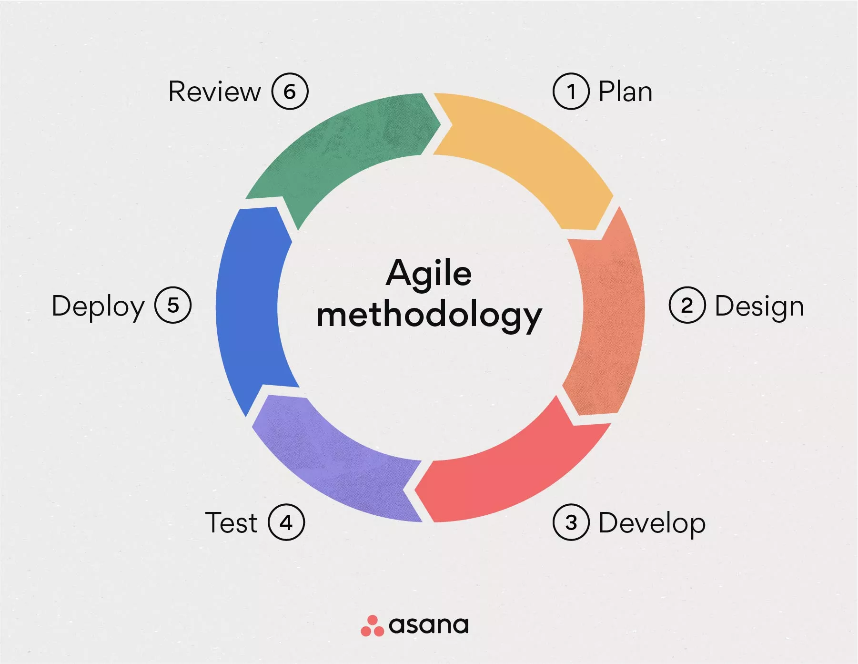

Post Mortem Analysis
What did you learn about team or large project development? What will you start doing, keep doing, or stop doing next time?
Notes:
Communication: Effective communication is crucial for the success of large projects. Clear and frequent communication helps ensure that all team members are aligned with project goals, deadlines, and expectations.
Collaboration: Collaboration among ourselves was essential for leveraging our diverse perspectives and skills, which helps us to problem solve together in a more effective way.
Agile Approach: With an agile approach,it improves the team’s flexibility and adaptability, as we were able to break work down into smaller tasks and adjust strategies efficiently based on feedbacks.
These things are what we will keep doing for future group projects.

Slide 24

Post Mortem Analysis
Can you draw any conclusions from what you've done?
Notes:
Reflecting on our journey developing the application, we've learned the vital significance of user-focused design, agility, and having a collaborative team dynamics. Our commitment to continuous learning and celebrating milestones has been crucial, guiding our future pursuits towards innovation and excellence.

Slide 25
Conclusion
In conclusion, Farmers Hub App emerges as a beacon of innovation in the agriculture sector, revolutionizing the way farmers connect with consumers and other farmers. Our platform serves as a dynamic link, empowering farmers to directly sell their produce and machinery, bypassing middlemen and ensuring fairer returns for their hard work.
By fostering direct trade, Farmers Hub promotes transparency, efficiency, and community-building within the agricultural sector. Our commitment to empowering farmers is evident in our mission to revolutionize agricultural trade and nurture sustainable growth.
Join us as we embark on this journey to reshape the agricultural landscape, one connection at a time. Together, let's cultivate a future where farmers thrive in a dynamic and interconnected marketplace.

Slide 26
Thank You For Listening!

Slide 27
Customer Video 2

